Slide 1
Probabilistic Analysis of the Different Shots in the Sport of Squash
Kaushal S. Kirpekar & Prathamesh D. Anwekar
Birla Institute of Technology and Science, Pilani
December 14, 2022
Probabilistic Analysis of Squash

Slide 2
Outline
Introduction
Framework for Analysis
Shot Analysis
Analysis and simulation results
Conclusions
Probabilistic Analysis of Squash

Slide 3
INTRODUCTION
The game of squash is a high-intensity sport that requires a combination of physical fitness, mental agility, and strategic thinking. It is a popular and competitive sport that is played by millions of people around the world.
One way to analyze the strategies used in squash is using probabilistic analysis. Probabilistic analysis is a statistical method that uses probability theory to study the likelihood of different events occurring.
In the context of squash, probabilistic analysis can be used to study the distribution of different types of shots from different areas of the court. This can provide valuable insights into the strategies that players use, and can also be used to improve the performance of players at all levels of the game.
Probabilistic Analysis of Squash

Slide 4
MOTIVATION
We have opted for this sport as it is one of the less popular sports in the world and there is not much data and analytics available for this sport.
We hope to assist coaches around the world base their tactics on our findings and studies and help them analyse the game better and to train their players more strategically.
This project also demonstrates the difference between the shot selection and error/winner probability for professional level players and intermediate level players.
Probabilistic Analysis of Squash

Slide 5
ACKNOWLEDGMENT
We would like to thank Professor Sainath Bitragunta for providing us the opportunity to do this project under his guidance, and for all the resources he shared with us throughout the course of this project.
Probabilistic Analysis of Squash

Slide 6
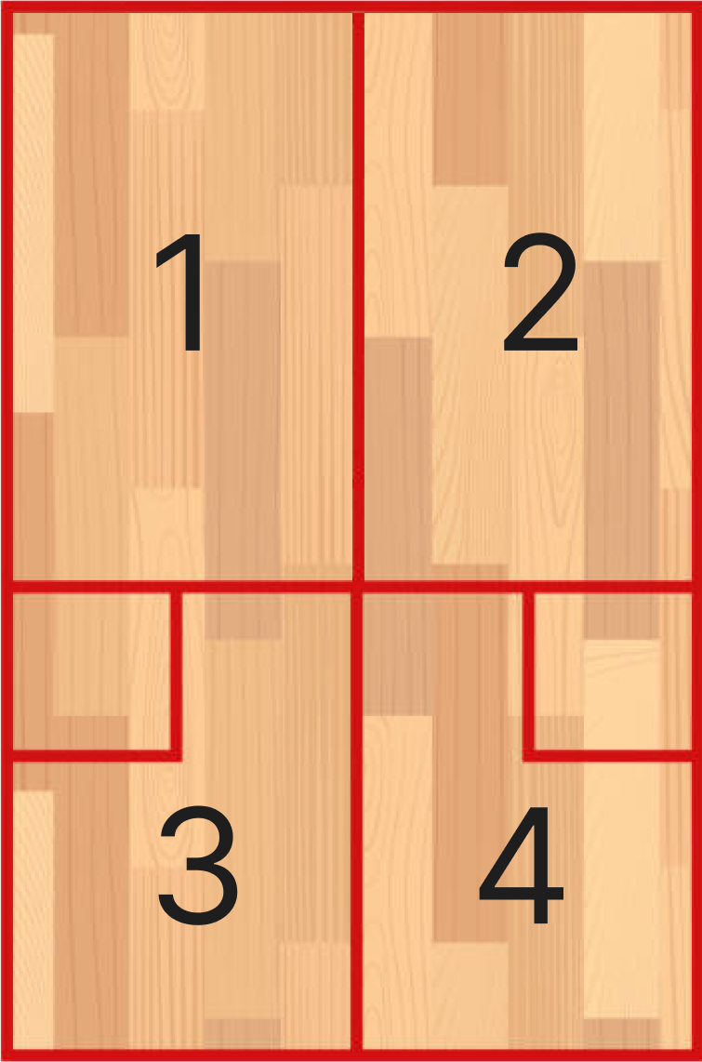
FRAMEWORK OF ANALYSIS
For analyzing the shot probability for different regions of the court, we have divided the court into four regions as shown in the image below:
Probabilistic Analysis of Squash

Slide 7
FRAMEWORK OF ANALYSIS
For analyzing the shot probability for different types of shots, we have divided the shots into the following categories:
Forehand Parallel Drive
Forehand Cross Drive
Forehand Lob
Forehand Boast
Forehand Back-wall
Forehand Drop
Backhand Parallel Drive
Backhand Cross Drive
Backhand Lob
Backhand Boast
Backhand Back-wall
Backhand Drop
Probabilistic Analysis of Squash

Slide 8
FRAMEWORK OF ANALYSIS
For analyzing the result of different types of shots played, we have divided the shot outcomes into the following categories:
Normal Shot
Winner
Forced Error
Unforced Error
Probabilistic Analysis of Squash

Slide 9
SHOT ANALYSIS
A total of 4 matches of professional level and 4 matches of intermediate level were analyzed. Professional players include the top 10-15 squash players in the world as ranked by the Professional Squash Association(PSA), while matches of university level squash teams were analyzed to make up the intermediate level.
An approximate total of 900 shots of the professional level matches and 500 shots of the intermediate level matches were used to perform the analysis and draw conclusions.
The following assumptions were made while analyzing the shots:
The shots leading to let or stroke were not counted for analysis.
The service shots were not counted for analysis.
The volley shots were not considered as a separate type.
We have performed the entire analysis for right-handed players and hence the terminologies used relate to the same.
Probabilistic Analysis of Squash

Slide 10
SHOT ANALYSIS
The following graphs depict the shot distribution for the different regions for the professional matches:
Probabilistic Analysis of Squash

Slide 11
SHOT ANALYSIS
Probabilistic Analysis of Squash

Slide 12
SHOT ANALYSIS
Probabilistic Analysis of Squash

Slide 13
SHOT ANALYSIS
Probabilistic Analysis of Squash

Slide 14
SHOT ANALYSIS
The following graphs depict the shot distribution for the different regions for the intermediate matches:
Probabilistic Analysis of Squash

Slide 15
SHOT ANALYSIS
Probabilistic Analysis of Squash

Slide 16
SHOT ANALYSIS
Probabilistic Analysis of Squash

Slide 17
SHOT ANALYSIS
Probabilistic Analysis of Squash

Slide 18
ANALYSIS RESULTS
On analyzing the shots, it was observed that the following shot was the most played for each region listed below:
Region-1: Professionals: Backhand Drop
Intermediates: Backhand Drop
Region-2: Professionals: Forehand Cross
Intermediates: Forehand Parallel
3. Region-3: Professionals: Backhand Parallel
Intermediates: Backhand Parallel
4. Region-4: Professionals: Forehand Cross
Intermediates: Forehand Parallel
Probabilistic Analysis of Squash

Slide 19
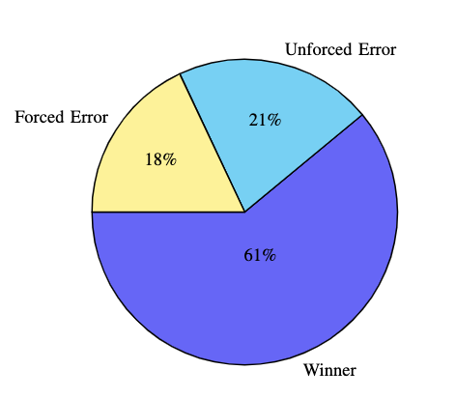
ANALYSIS RESULTS
On analyzing the outcome of the shots, the following pie chart shows the distribution of the shot outcome:
PROFESSIONAL LEVEL
Probabilistic Analysis of Squash

Slide 20
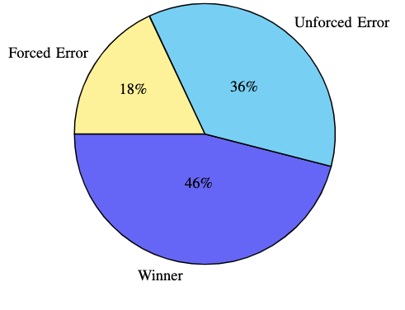
ANALYSIS RESULTS
INTERMEDIATE LEVEL
Probabilistic Analysis of Squash

Slide 21
ANALYSIS RESULTS
WINNER SHOT ANALYSIS
At the professional level, most winners were produced from the Backhand Drop shot (40%), followed by the Forehand Drop Shot (24%).
At the intermediate level, most winners were produced from the Forehand parallel Shot (58%).
Probabilistic Analysis of Squash

Slide 22
ANALYSIS RESULTS
2) FORCED ERROR SHOT ANALYSIS
At the professional level, most forced errors were produced from the Backhand Drop shot (42%), followed by the Back-hand Boast Shot (17%).
At the intermediate level, most forced errors were produced from the Backhand parallel Shot (34%).
Probabilistic Analysis of Squash

Slide 23
ANALYSIS RESULTS
3) UNFORCED ERROR SHOT ANALYSIS
At the professional level, most unforced errors were produced from the Backhand Drop shot (53%), followed by the Forehand Boast Shot (15%).
At the intermediate level, most forced errors were produced from the Backhand drop Shot (40%)
Probabilistic Analysis of Squash

Slide 24
FINAL CONCLUSIONS
At the professional level, 61 percentage of points are won by winners from either player, whereas at the intermediate level, this percentage is 46.
At the professional level, 21 percentage of points are won as a result of unforced error from either player, whereas at the intermediate level, this percentage is 36, showing the difference in quality between the two.
From the shot analysis, it can be seen that most of the match at the both the professional and intermediate level takes place in the rear part of the court, which is down to the reason that this adds more control to the game. Moreover, the backhand rear side of the court is the region that is most operated by the players, playing the Backhand Parallel shot with utmost skill to keep the ball moving.
Probabilistic Analysis of Squash

Slide 25
FINAL CONCLUSIONS
From the probabilistic analysis, it can be observed that at both the professional and intermediate level, the shot that produces unforced errors is the Backhand Drop shot, but the upside of this shot is very high as it also produces the most winners at the professional level. Hence, this is a shot that every player should focus on mastering.
It is also observed that the back-wall shots are only played at the rear end of the court, and similarly the lob shots are mainly played in the front regions of the court.
Probabilistic Analysis of Squash

Slide 26
REFERENCES
Mathematical Modeling and Success Probability Analysis of Basketball Shots-Kaivalya Dabhadkar, Adeesh Bhargava, and Sainath Bitragunta
Williams, Benjamin & Bourdon, Pitre & Graham-Smith, Philip & Sinclair, Peter. (2015). A quantitative analysis of squash shot accuracy.
https://github.com/PrathameshAnwekar/SOP-SquashProbabilisticAnalysis
https://sportspages.in/squash/squash-court-dimensions/
Low, Jeff & Sankaravel, Mohansundar & mohd rasyid, Nelfianty & Tengah, R.Y.. (2017). Performance analysis of the Malaysian elite youth squash players. Journal of Fundamental and Applied Sciences. 2017. 9-1074. 10.4314/jfas.v9i6s.79.
Probabilistic Analysis of Squash

Slide 27
END
THANK YOU
Probabilistic Analysis of Squash

